Slide 1
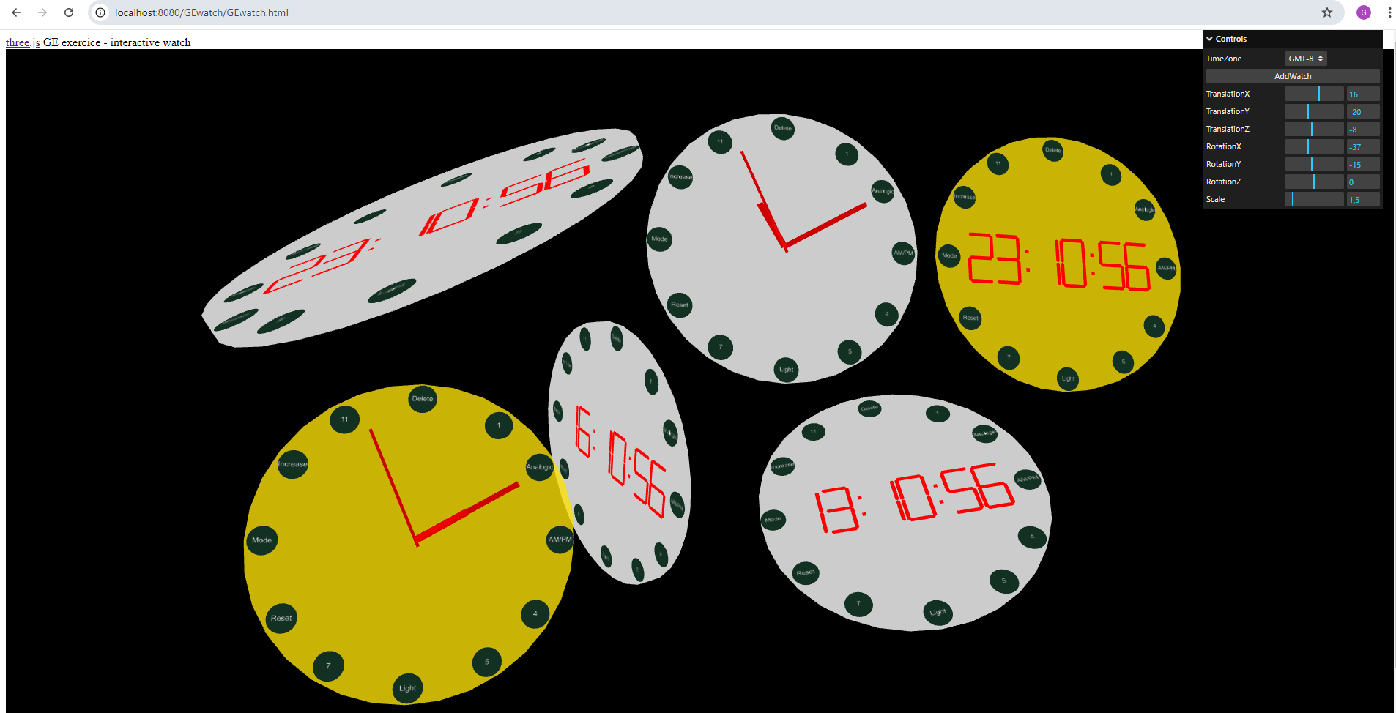
Create watches
MVC pattern with View and Controllers from Three.JS release 168

Slide 2
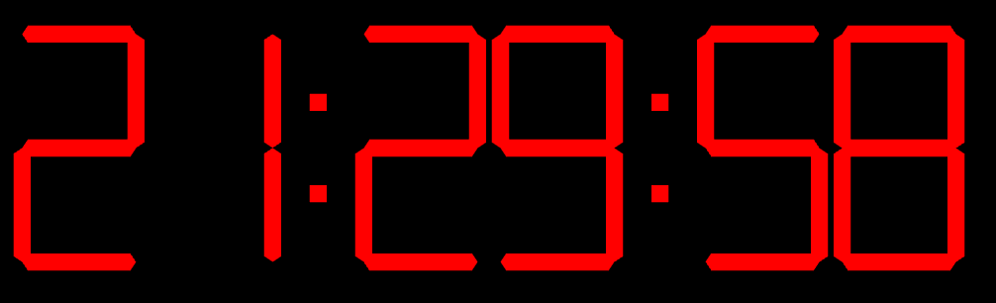
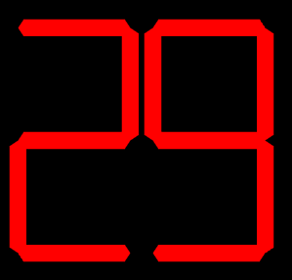

Model class diagram ( PartA )
Display requirements ( PartA )
Local time in format hh:mm:ss
Increment every second
Trailing zero in case of single digit hour, minute, second.
WatchModel
TwoDigitalNumber
DigitalNumber
- Hours:TwoDigitalNumber
- Minutes:TwoDigitalNumber
- Seconds:TwoDigitalNumber
- First:DigitalNumber
- Second:DigitalNumber
- Group:ThreeGroup
- Number:int
1
3
1
2
contains
contains
#Create
+setNumber( number:int )
+getNumber():int
+updateNumber(number:int)
+Update()
#initNumbers()
#initDots()
#Init()
+Update( number:int )
View render

Slide 3
State machine diagram ( PartA )
Edit requirements & UI ( PartA )
Press one time mode button, hours blink and are editable.
Press second time mode button, minutes blink and are editable.
Press third time mode button, no more blink.
Increase button for hours and minutes.
Light button switch between white and yellow
press Mode button
Initial state
press Mode button
Hours blink
& editable
press Mode button
Minutes blink
& editable
press Increase button
press Increase button
Hours increases
(up to 23 then 00)
Minutes increases
(up to 59 then 00 plus increase hours)
watchFace
white
press Light button
watchFace
yellow
press Light button

Slide 4
Model class diagram with edit functionalities ( PartA )
MODEL
TwoDigitalNumber
DigitalNumber
WatchModel
- First:DigitalNumber
- Second:DigitalNumber
- Group:ThreeGroup
- Number:int
-Hours:TwoDigitalNumber
-Minutes:TwoDigitalNumber
-Seconds:TwoDigitalNumber
-deltaHours:int
-deltaMinutes:int
1
2
1
3
contains
#Create
+setNumber( number:int )
+getNumber():int
+updateNumber( number:int)
contains
#Init()
+Update( number:int )
+Update()
#initNumbers()
#initDots()
#initWatchButtons()
#initWatchFace()
+setWatchFaceColor( color:color )
+increaseHours()
+increaseMinutes()
WatchButton
-name:string
-positionX:float
-position:float
-positionZ:float
1
n
contains
Updates
#init( name, positionX, position, positionZ )
Manipulate model
Three:Controllers
Three:View
-Scene
-Camera
-Container
-OrbitControls
-Raycaster
#onPointerDown(event:event)
#onWindowResize()
#Init
#Animate()
#Render()

Slide 5
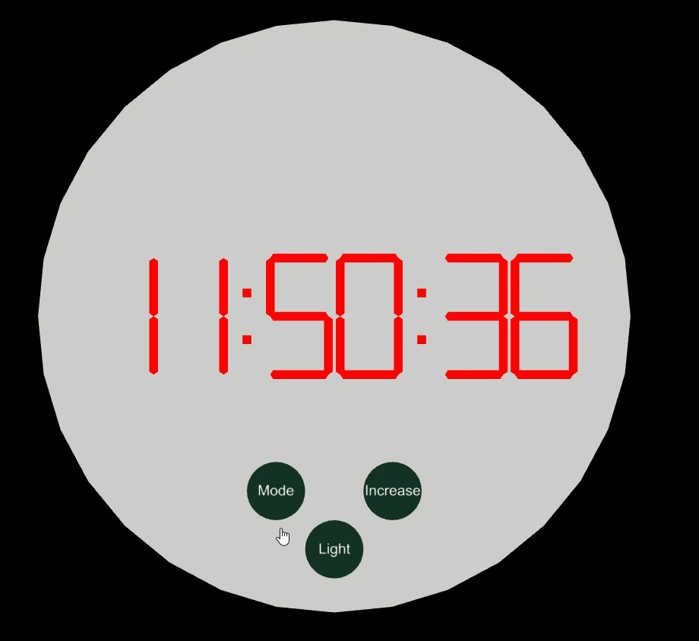
Watch render and user interactions ( PartA )

